Slide 1
Procedural Map Generation
By Pablo Galve

Slide 2
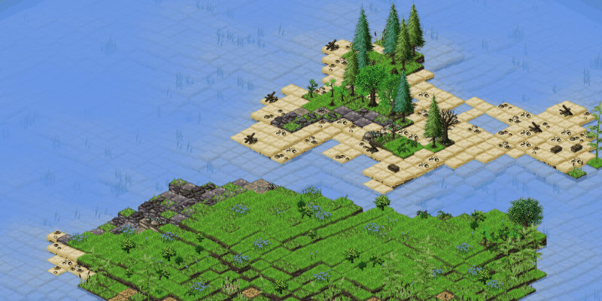
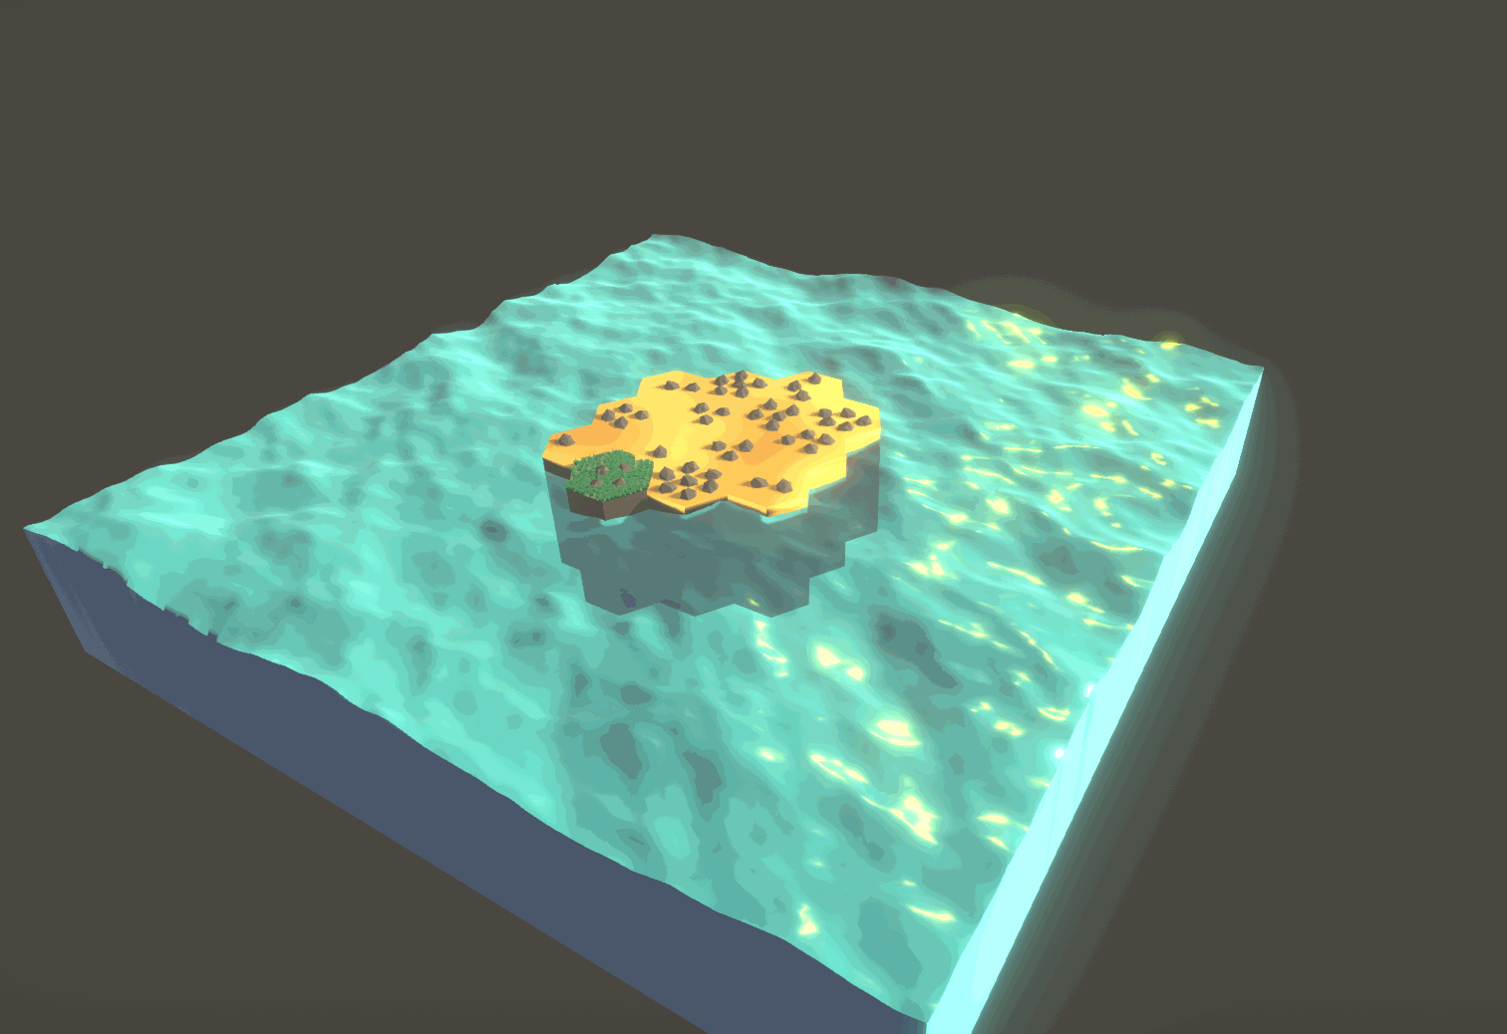
What is procedural map generation?
A map generated by a computer, not a human

Slide 3

Why to use procedural map generation?
Pros
Each map is mathematically unique
Saves development time
Monetization can dramatically increase
Users play for years
Perfect for creating a lot of maps
Cons
Hard to make it visually unique
Computers are not creative
You can’t design it 100% as you want
Bad for narrative games
Bad for building only one map

Slide 4
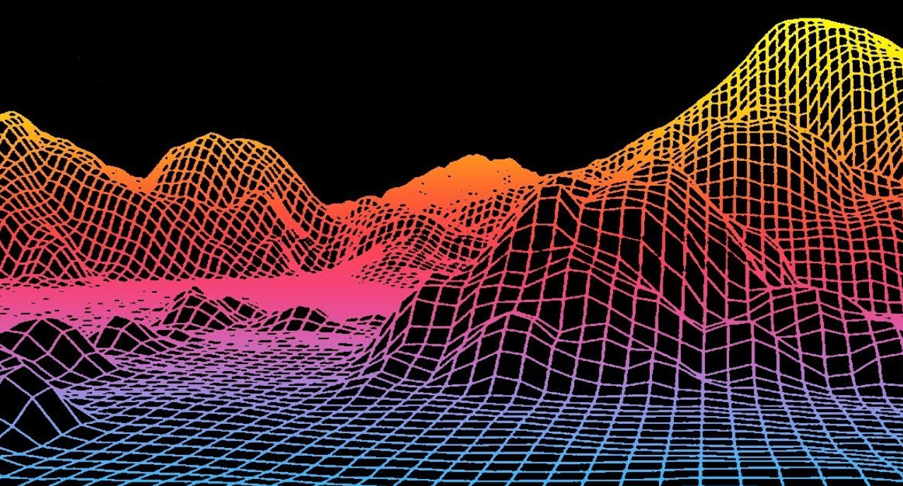
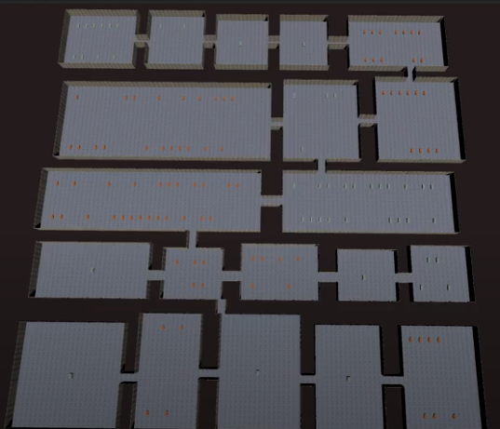
Different type of maps
Outdoor maps
Using Perlin Noise
In this tutorial, we’ll see how to generate outdoor maps
Indoor / Dungeon maps
Explained in my website

Slide 5


What is Perlin Noise?
Normal Noise
Perlin Noise

Slide 6
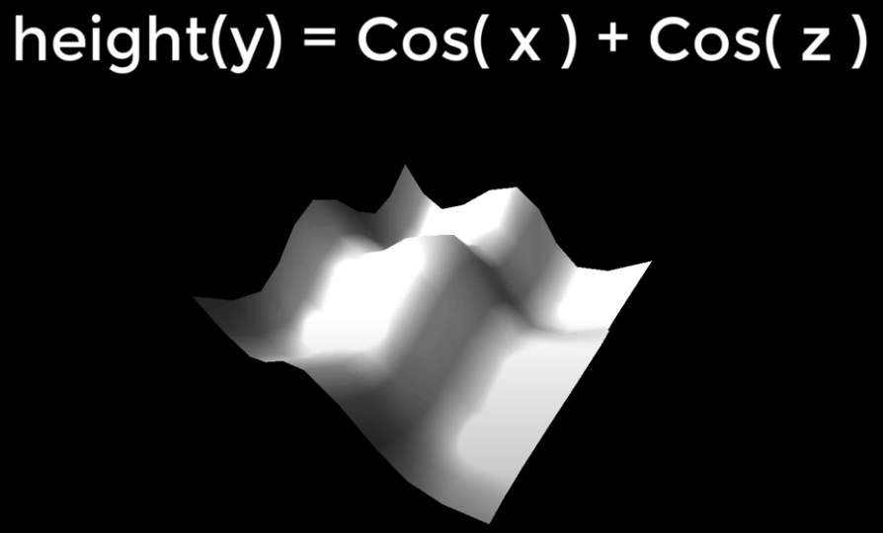
How to create infinite worlds
We only need to store
Coordinates
A math formula
Changelog made by player
Same seed = Same world

Slide 7
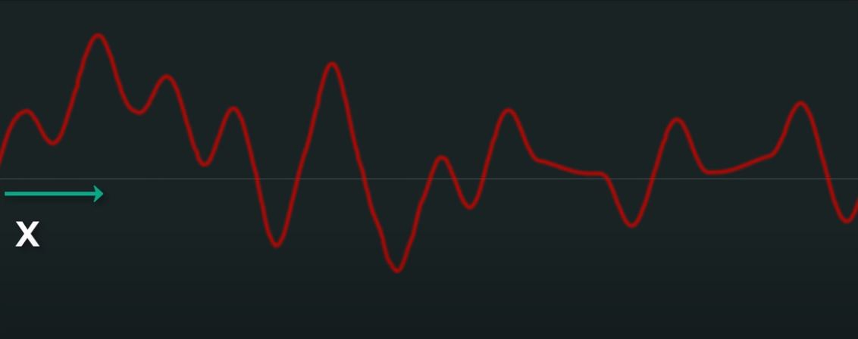
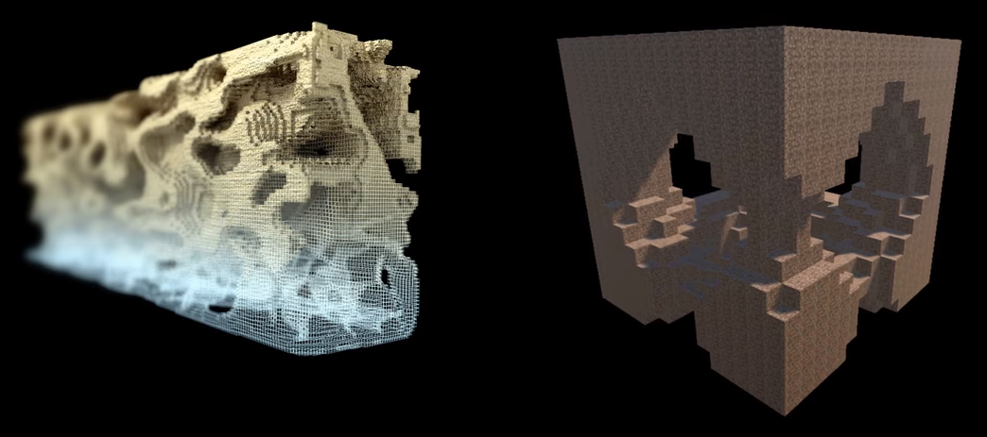
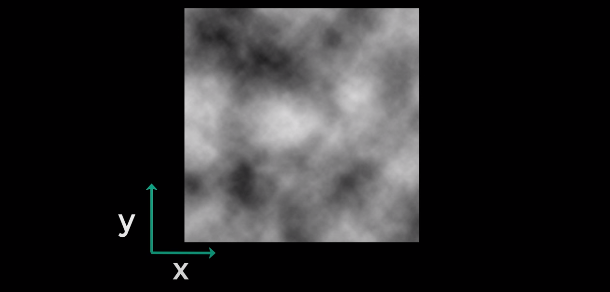
Perlin Noise - 1D, 2D & 3D

Slide 8
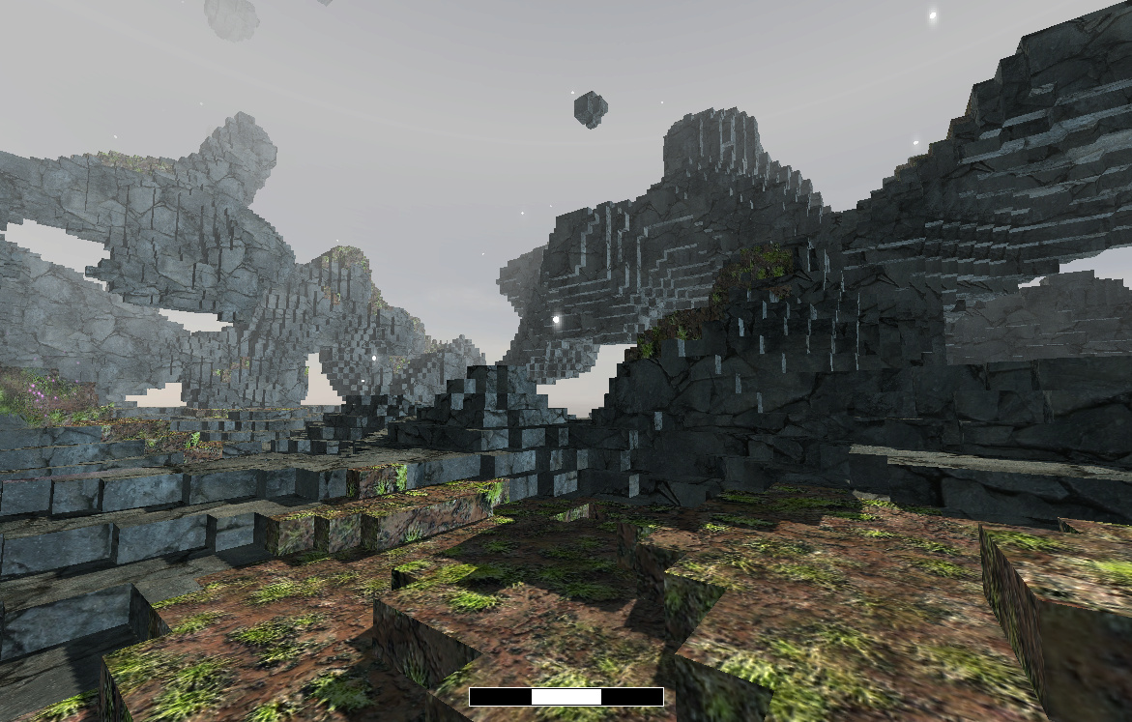
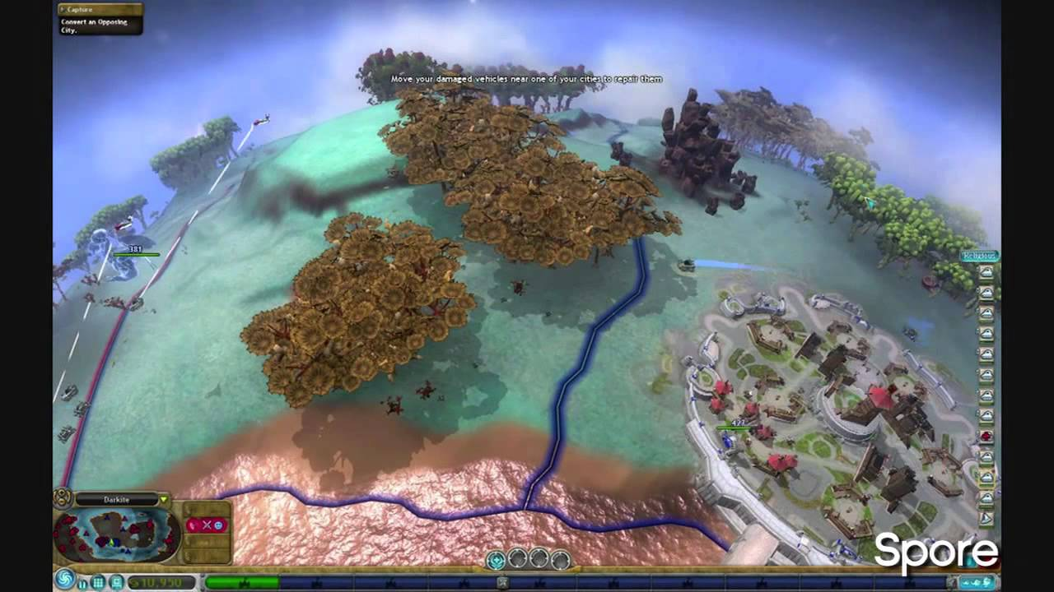
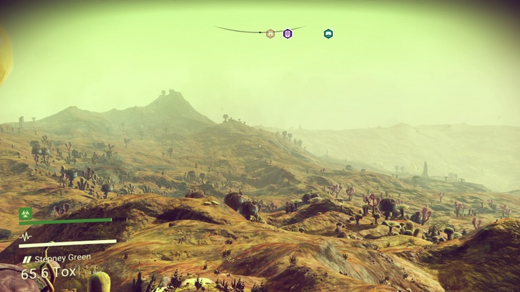
Games using procedural generation
Minecraft
Spore
No Man’s Sky

Slide 9
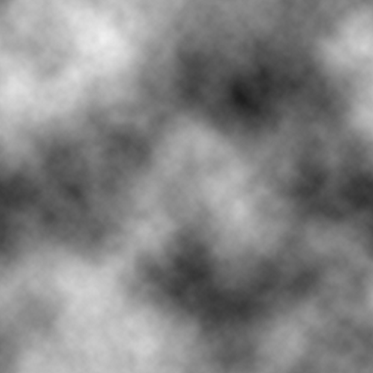

TODO 1: Generate Perlin Noise
Create a FastNoise object
Set noise type to “Perlin”
Set frequency to 0.03
Uncomment myObject.SetSeed(seed)
Output:
You won’t see anything on screen yet

Slide 10
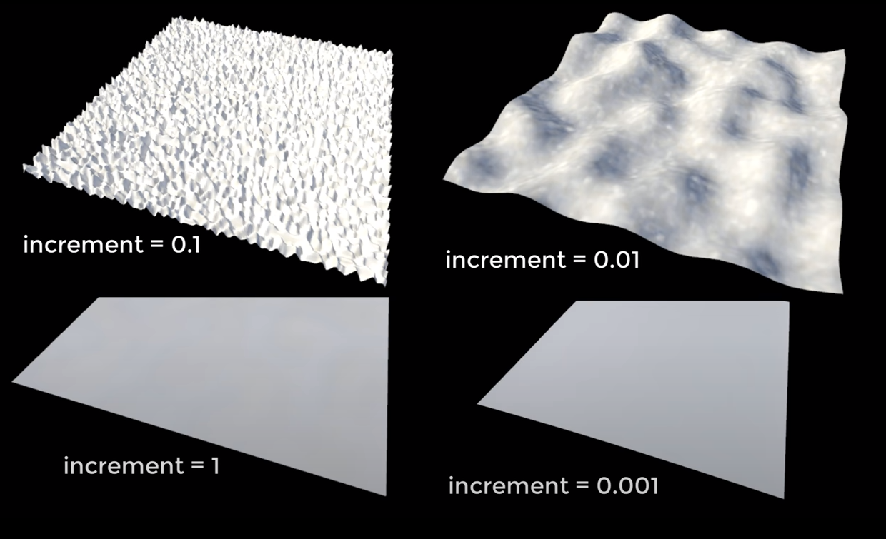
Why set frequency as 0.03?
To avoid problems like that
Frequency is the same as Increment

Slide 11
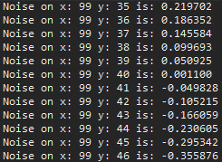
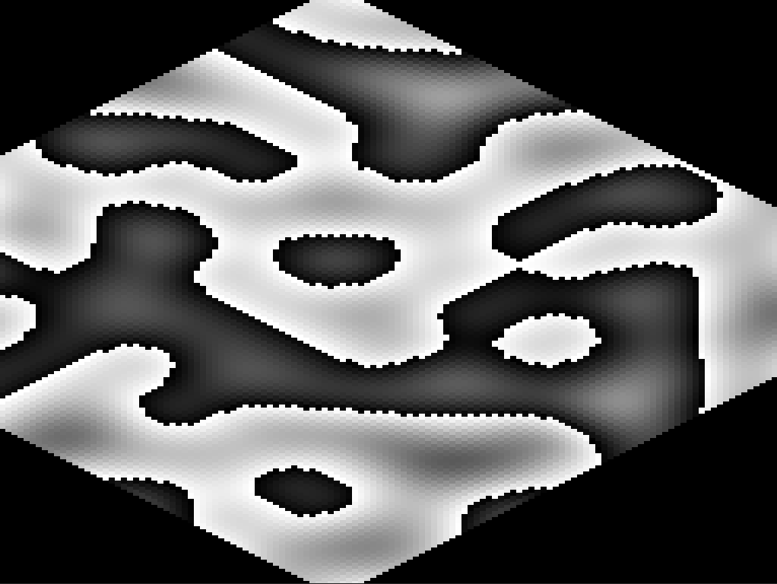
TODO 2.1: Store Perlin Noise
We have a loop from 0-100 both in x and y
Get noise at your desired coordinates
Store values in “height_map” variable
Output:
You should have an output in console with values
And you will see that on screen

Slide 12
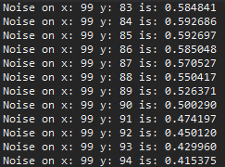
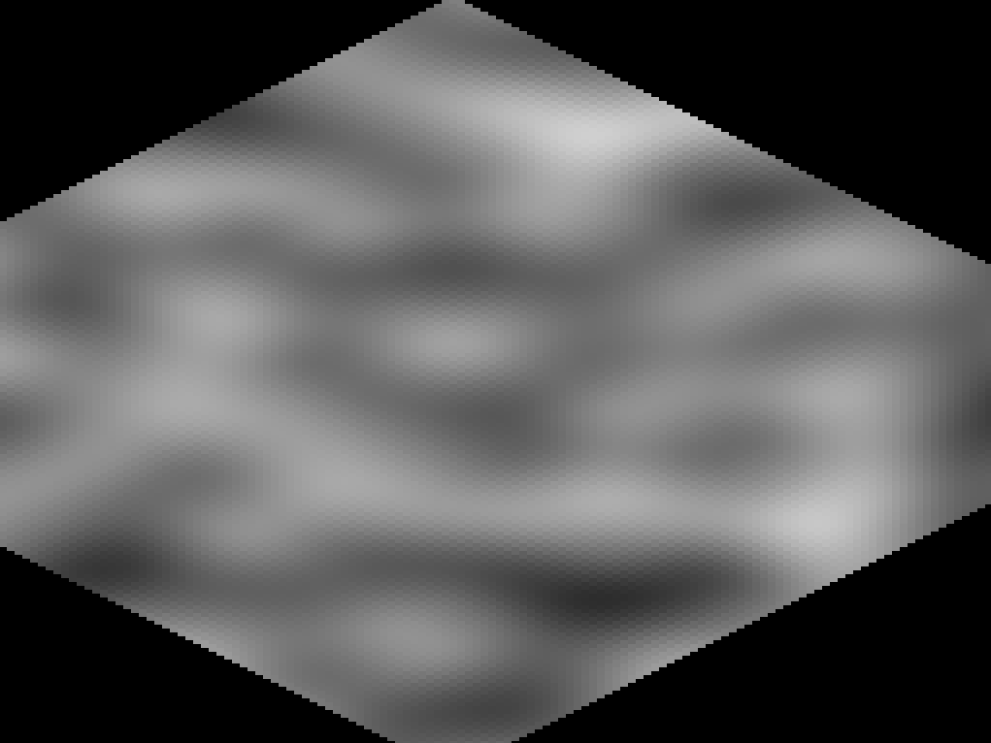
TODO 2.2: Adjust Perlin Noise to 0-1
We have a problem:
Some results are negative
We need to fix that!
Use that formula: (Noise + 1) * 0.5
Output:
You will always have values between 0 and 1
You’ll see that on screen

Slide 13
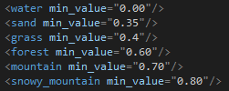
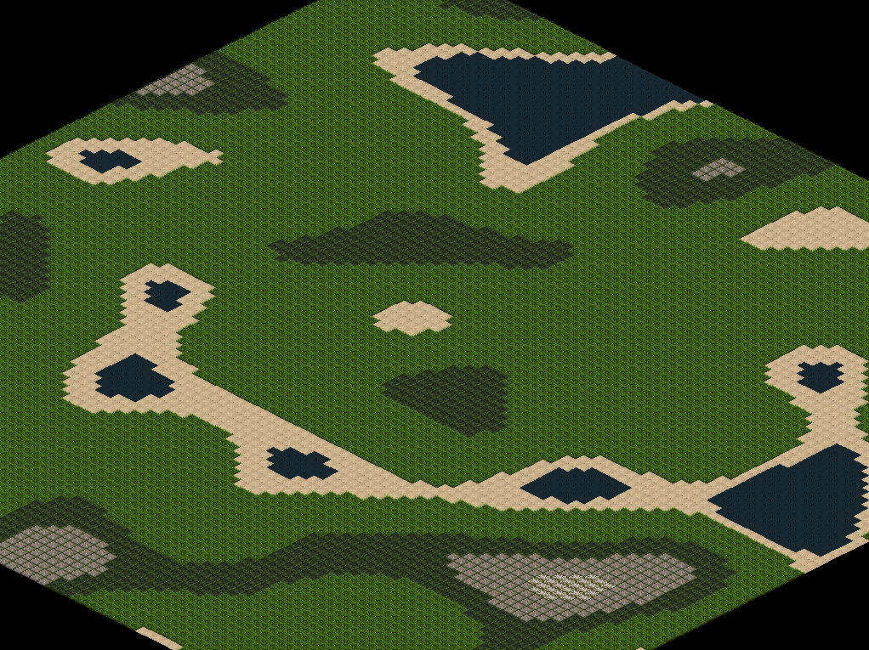
TODO 3: Draw Map from height_map
0 are low areas (valleys) and 1 are high areas (mountains)
We have different textures:
Water, sand, grass, forest, mountain and snowy mountain
Blit them depending on the value
I used
Output:
You will see exactly this same map

Slide 14
TODO 4: Generate a random seed
Seeds are usually current time in milliseconds
An example of a seed is: 1587313622000
Output:
Nothing will change

Slide 15
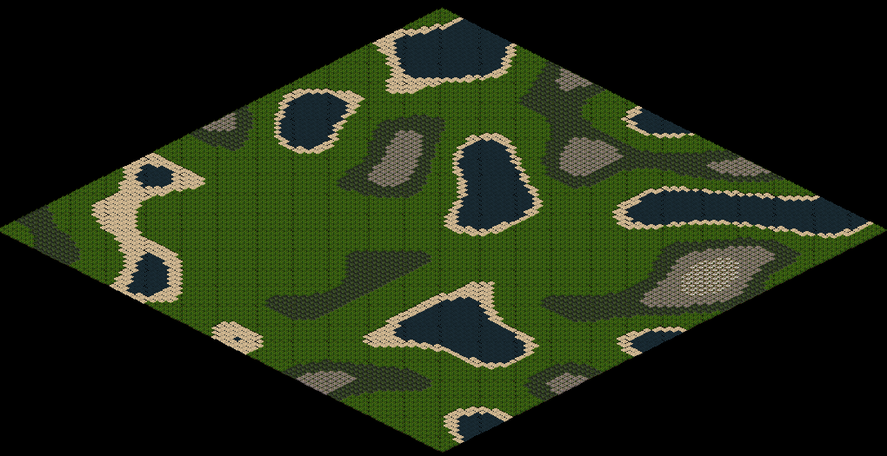
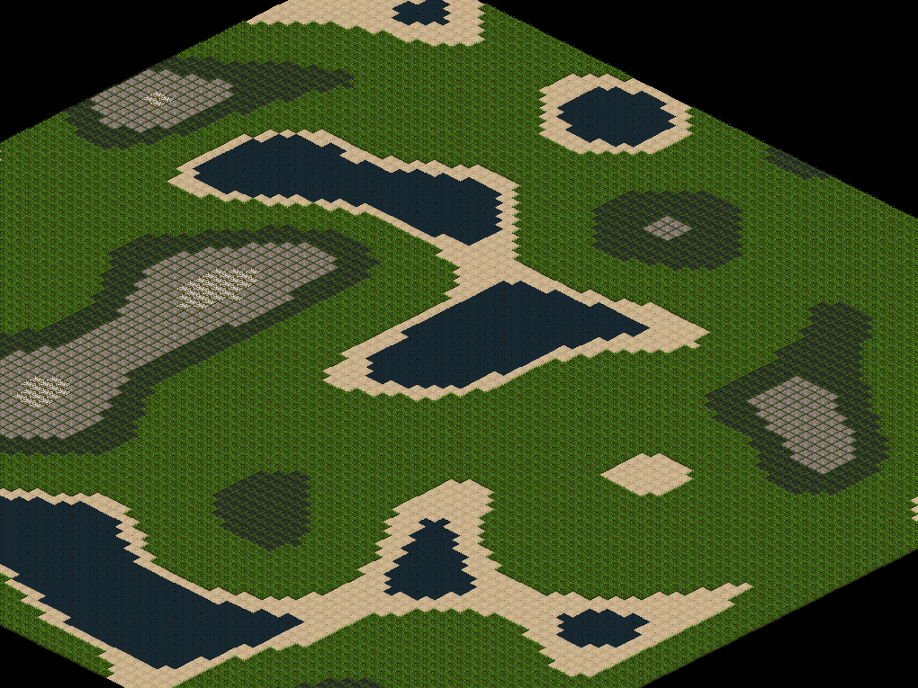
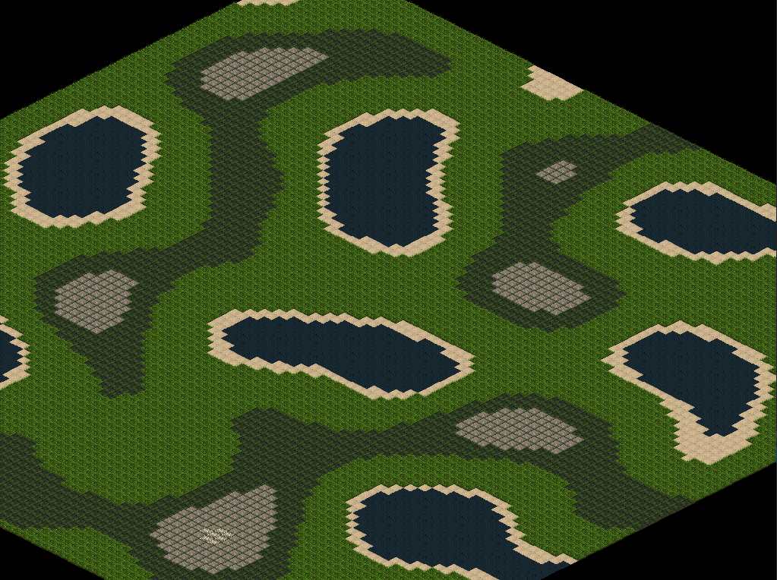
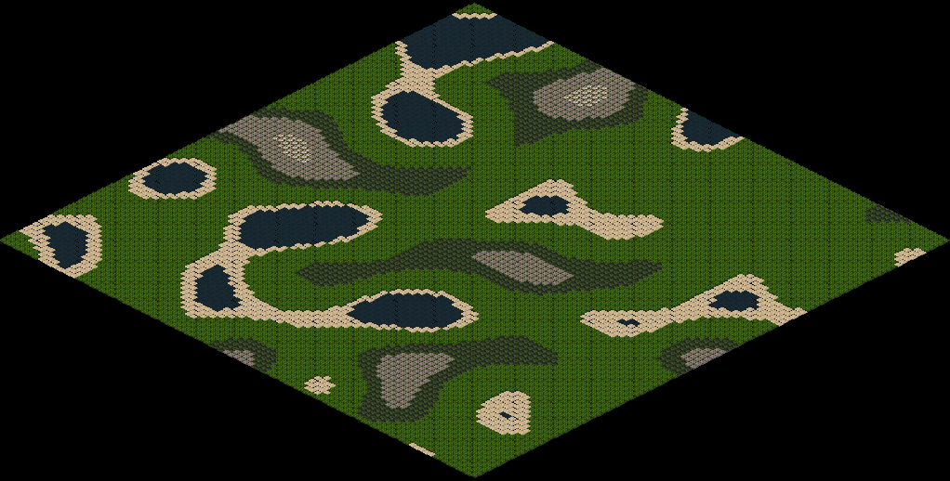
TODO 5: Use the seed
Pass the seed as an argument to generatePerlinNoise()
Output:
The map will be different each time or if you press space

Slide 16
Optional Homework - Infinite Map
Occlusion Culling - Render only what is on screen
Generate perlin noise for all the coordinates seen in screen
Not only from [0][0] to [100][100] like in the TODOs
You should be able to render an infinite map with that

